Slide 1
STATISTICS
BUDI WARSITO

Slide 2
STATISTICS
STATISTICS :
MAKE A CONCLUSSION OF A POPULATION BASED ON SAMPLE DATA
POPULATION
SAMPLE

Slide 3
STATISTICS
STATISTICS : PROCESS EFFICIENCY
A STATISTIC ESTIMATES A QUANTITY THAT WE NEED TO KNOW ABOUT BUT CANNOT OBSERVE DIRECTLY

Slide 4
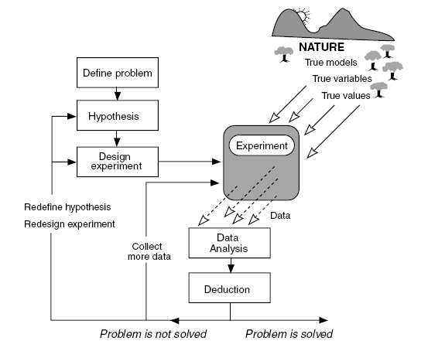
DESIGN EXPERIMENT TO PROBLEM SOLVING

Slide 5
SUMMARY : MATERY FROM THE FIRST LECTURER
PROBABILITY
BAYES THEOREM
RANDOM VARIABLE
DISCRETE PROBABILITY DENSITY FUNCTION (BINOMIAL & POISSON)
CONTINUE PROBABILITY DENSITY FUNCTION (NORMAL, t, CHI-SQUARE)

Slide 6
MATERY FROM THE SECOND LECTURER
TESTING HYPOTHESIS
ONE SAMPLE T-TEST
INDEPENDENT SAMPLE T-TEST
PAIRED SAMPLE T-TEST
ONE-WAY ANOVA
MULTI-WAY ANOVA (optional)
CORRELATION
REGRESSION
ONE-WAY MANOVA (optional)
MULTI-WAY MANOVA (optional)
CLUSTERING (optional)

Slide 7
SOME QUESTIONS
WHAT IS THE MEANING OF :
α = 5% AND 1- α = 95%
WHAT IS THE DIFFERENCE BETWEEN CORRELATION & REGRESSION ?
WHAT IS THE DIFFERENCE BETWEEN PAIRED & INDEPENDENT SAMPLE T-TEST?
WHAT IS THE DIFFERENCE BETWEEN ONE-WAY & MULTI (TWO) WAY ANOVA?

